Slide 1
Introduction
What is a Prototype?
A prototype is a draft version or an approximation of a final product.
Prototypes are developed for several reasons:
to identify possible problems.
to confirm the suitability of a design prior to starting mass production.
Provides a scale model performance.
for visualization purposes.

Slide 2
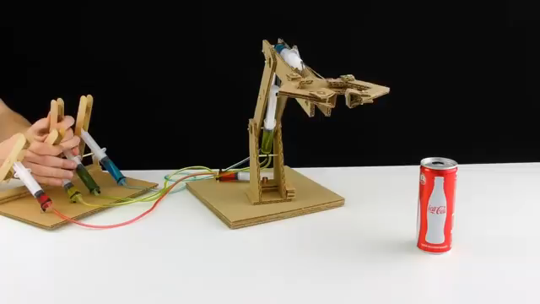
Prototype 1- Hydraulic Powered Robotic Arm

Slide 3

Prototype 2- V8 Engine Model

Slide 4
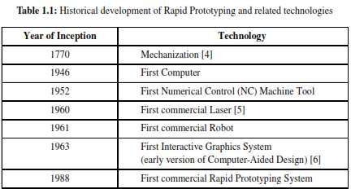
Development of Rapid Prototyping
Rapid Prototyping
Mid 1980’s
Hard prototype made in a very short turnaround time (relies on CAD
modelling)
Prototype can be used for limited testing
prototype can consist in the manufacturing of the products
3 times complex as soft prototyping

Slide 5
Types of Prototype
Prototyping plays a crucial role in digital fabrication and manufacturing processes, allowing designers and engineers to test and validate their concepts before full-scale production
Proof-of-Concept Prototypes:
Role: To demonstrate the feasibility of a concept or idea.
Characteristics: Basic, low-fidelity prototypes that focus on key functionalities.
Visual Prototypes:
Role: To showcase the visual design and aesthetics.
Characteristics: High-fidelity models or renders that emphasize the appearance of the final product without functional details.
Functional Prototypes:
Role: To test and validate the functionality of a product.
Characteristics: Prototypes that closely simulate the actual performance and behavior of the final product.
User Experience (UX) Prototypes:
Role: To evaluate the overall user experience.
Characteristics: Interactive prototypes that allow users to navigate and interact with the product, providing insights into usability and design.
Notes:
Low fidelity models: basic representations of a product or system that are created quickly and with minimal detail.

Slide 6
Form Prototypes:
Role: To assess the physical form and ergonomics of a product.
Characteristics: Physical models that represent the size, shape, and tactile qualities of the final product.
Alpha Prototypes:
Role: To create an early version with all core features for internal testing.
Characteristics: Fully functional prototypes used for in-house testing and refinement.
Beta Prototypes:
Role: To gather feedback from external users before final production.
Characteristics: Prototypes released to a limited audience for real-world testing and user feedback.
Rapid Prototypes:
Role: To quickly iterate (perform or repeat an action) and test design ideas.
Characteristics: Utilizes rapid prototyping techniques like 3D printing, CNC machining, or laser cutting to produce prototypes in a short time.

Slide 7
9. Virtual Prototypes:
Role: To simulate the behavior of a physical product in a digital environment.
Characteristics: Computer-generated models that allow for testing and analysis in a virtual space.
10. Scaled Prototypes:
Role: To represent a smaller or larger version of the final product.
Characteristics: Maintains the proportions and key features but may not be fully functional.

Slide 8
Need of digital manufacturing
Keep it in-house – With a 3D printer and the right software, you can produce small batches of products on your own premises without the need for external vendors
Easy to test – Have an idea? With digital fabrication, you can bring it to life and see if it’s feasible. It helps you gain valuable insight into your customer needs, the marketplace and anything else that can spell the difference between success and failure
Save money – Because you’re only making prototypes or small batches of a product, you won’t need much storage space. You can also save money on materials by using lower-grade supplies or even recycled plastic
Save time – Digital fabrication accelerates the process of product development as you can create prototypes much more quickly than traditional manufacturing methods, with no need to outsource
Spot errors early – Engineers like digital fabrication because it helps them spot any issues that exist within days rather than months

Slide 9
Rapid Prototyping
Rapid prototyping (RP) is a group of techniques used to quickly fabricate a scale model of a physical part or assembly using three-dimensional computer-aided design (CAD) data. The primary goal of rapid prototyping is to allow for swift iteration, testing, and refinement of design concepts before full-scale production.
Phases of Rapid Prototyping:
Conceptualization:
Goal: Clearly define the product concept and design objectives.
Activities: Idea generation, concept sketching, and establishing design specifications.
Design:
Goal: Develop a detailed 3D digital model of the product.
Activities: Computer-Aided Design (CAD) is used to create a virtual representation, specifying dimensions, materials, and features.
Pre-Processing:
Goal: Prepare the digital model for physical prototyping.
Activities: Data verification, slicing the digital model into layers, and generating the toolpath data required for fabrication.

Slide 10
4. Rapid Prototyping Process:
Goal: Transform the digital model into a physical prototype.
Activities: Utilize additive manufacturing technologies such as 3D printing, stereolithography (SLA), selective laser sintering (SLS), or other methods to build the prototype layer by layer.
5. Post-Processing:
Goal: Refine and finish the physical prototype.
Activities: Remove support structures, sanding, painting, and any necessary post-processing steps to enhance the prototype's appearance and functionality.
6. Testing and Evaluation:
Goal: Assess the prototype's performance and gather feedback.
Activities: Conduct functional and usability tests, evaluate against design specifications, and gather input from stakeholders.
7. Iteration:
Goal: Implement design modifications based on testing and feedback.
Activities: Make necessary adjustments to the digital model and repeat the rapid prototyping process to create a new iteration.
8. Finalization:
Goal: Develop a refined prototype ready for production.
Activities: Incorporate all design modifications, conduct final testing, and prepare for mass production if applicable.

Slide 11
Basic operating principles of RP
Building computer model
Model is build by CAD/CAM system.
Model must be defined as enclosed volume or solid.
Converting model into STL file format
Stereo Lithography (STL) file is a standard format to describe CAD geometry used in RP system.
STL file approximates the surfaces of the model by polygons.

Slide 12
Fabricating the model
Building model layer by layer.
Forming a 3D model by solidification of liquid/powder.
Removing support structure and cleaning
After building Drain out extra material.
Cut out the prototype.
Cut out unnecessary support material.
Post processing
Includes surface finishing and other applications.
10

Slide 13
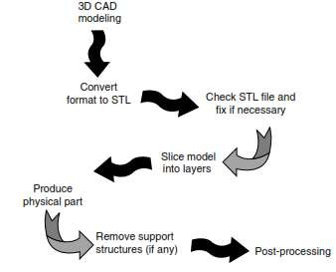
Steps involved in Rapid Prototyping
There are many different RP processes, but the basic operating principles are very similar.

Slide 14
Applications of RP
Applications of rapid prototyping can be classified into three categories:
Design
Engineering analysis and planning
Tooling and manufacturing

Slide 15
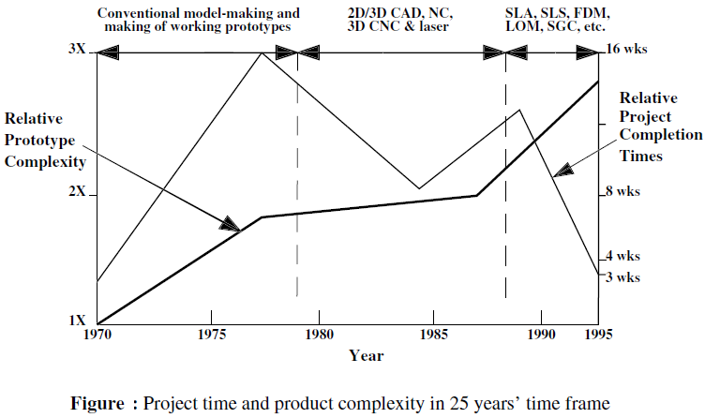
Advantages of Rapid Prototyping

Slide 16
Design Applications
Designers are able to confirm their design by building a real physical model in minimum time using RP
Design benefits of RP:
Reduced lead times to produce prototypes
Improved ability to visualize part geometry
Early detection of design errors
Increased capability to compute mass properties

Slide 17
Engineering Analysis and Planning
Existence of part allows certain engineering analysis and planning activities to be accomplished that would be more difficult without the physical entity
Comparison of different shapes and styles to determine aesthetic appeal
Wind tunnel testing of streamline shapes
Stress analysis of physical model
Fabrication of pre-production parts for process planning and tool design

Slide 18
Advantages of rapid prototyping
Accelerated Product Development:
Rapid prototyping enables faster iteration and development cycles.
Speeds up the overall product development process.
Early Visualization:
Provides a tangible model for stakeholders to visualize the final product.
Enhances communication between designers, developers, and clients.
Iterative Design:
Allows for quick design modifications based on feedback.
Facilitates continuous improvement and refinement of the product.
Reduced Costs:
Identifies design flaws early, reducing the need for expensive changes later.
Minimizes the risk of costly errors in the final product.
Customization and Personalization:
Supports the creation of customized prototypes for specific user needs.
Enables personalized design adjustments before mass production.
Enhanced Collaboration:
Fosters collaboration between cross-functional teams.
Encourages interdisciplinary input for better design outcomes.
15

Slide 19
Limitations of rp
Material Limitations:
Limited range of materials compared to traditional manufacturing processes.
Final product may differ in material properties.
Cost of Equipment:
High initial investment in prototyping equipment.
Affordability may be a barrier for small businesses or startups.
Scale-up Challenges:
Difficulty in scaling up production for mass manufacturing.
Prototyping may not be directly translatable to large-scale production methods.
Surface Finish and Resolution:
Prototypes may not achieve the same surface finish as final products.
Limited resolution in some rapid prototyping techniques.
Skill Requirements:
Skilled personnel are required to operate and maintain prototyping equipment.
Training and expertise may be necessary for effective utilization.
Validation Issues:
Prototypes may not always accurately represent the final product's performance.
Validation challenges in terms of functional and durability testing.
Environmental Impact:
Some rapid prototyping methods generate waste materials.
Environmental considerations may be a concern in certain processes.

Slide 20
Stereo Lithography Files
The stereo lithography file format, known as STL (Standard Tessellation Language), is the current industry standard data interface for rapid prototyping and manufacturing.
Before a 3D model is sent to a rapid prototype machine, it must be converted to this format.
From a user standpoint, the process typically requires only exporting or saving the model as an STL file. Some software packages, however, allow the user to define some specific parameters.
The STL file format defines the geometry of a model as a single mesh of triangles. Information about color, textures, materials, and other properties of the object are ignored in the STL file.
When a solid model is converted into an STL file, all features are consolidated into one geometric figure. The resulting STL file does not allow individual features created with the parametric modeling application to be edited.

Slide 21
Inventor .stl Save Procedure
Remember to use “Save Copy As” not “Save.”
Select .stl as file type

Slide 22
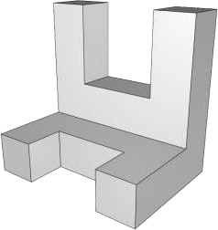
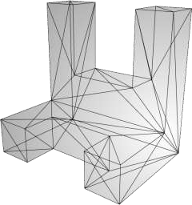
Stereo Lithography Files
The process of approximating the actual surfaces of the object with a
closed mesh of triangles is known as Tessellation.
When the tessellated STL file is sent to the rapid prototype machine, the model is sliced into multiple horizontal layers that are later reproduced physically by the device.
19

Slide 23
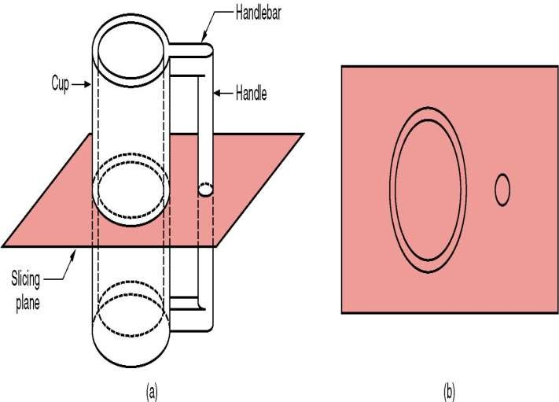
Why .STL file format?
The STL files translate the part geometry from a CAD system to the RP machine.
Universal file format that every system needs to be able to produce so that an RP machine can process model.
Slicing a part is easier compared to other methods such as B-rep (boundary representation) and CSG (constructive solid geometry)

Slide 24
RP – Two Basic Categories
Material removal RP –
In Material Removal RP, the process involves selectively removing material from a larger block or form to shape the final prototype. This is also known as subtractive manufacturing.
Example: CNC Machining (Computer Numerical Control Machining)
Process:
A computer-controlled machine tool (such as a milling machine or lathe) removes material from a solid block or billet.
The tool follows a programmed path to cut away excess material, layer by layer, until the final prototype is achieved.
Materials:
Metals, plastics, and composites are commonly used in CNC machining.
Material addition RP –
Adds layers of material one at a time to build the solid part from bottom to top. Example: Stereolithography (SLA) Photopolymer resins are commonly used
Process:
A liquid photopolymer resin is selectively exposed to ultraviolet (UV) light using a laser, solidifying the material layer by layer, until the entire prototype is formed.

Slide 25
Classification of RP Technologies
There are various ways to classify the RP techniques that have currently been developed
The RP classification used here is based on the form of the starting material:
Liquid-based
Solid-based
Powder-based
a) Liquid-Based:
Principle:
In liquid-based rapid prototyping, the starting material is in liquid form. Mostly resins and polymers
A layer of liquid is selectively solidified or cured to form each layer of the prototype.
Techniques:
Stereolithography (SLA): Uses a UV laser to solidify layers of liquid photopolymer resin.
Digital Light Processing (DLP): Similar to SLA but uses a digital light projector to cure entire layers at once.
PolyJet: Deposits droplets of liquid photopolymer that are cured with UV light.

Slide 26
Advantages:
High accuracy and fine details in the printed object.
Suitable for intricate and complex geometries.
b) Solid-Based:
Principle:
Solid-based rapid prototyping starts with a solid material that is selectively removed to form the desired shape. Starting material is a solid wood, plastic, metal sheets etc
Material removal or subtractive processes are commonly used.
Techniques:
CNC Machining: Uses computer-controlled tools to cut away material from a solid block or billet.
Laser Cutting: Utilizes a laser beam to cut through or engrave on solid materials.
Laminated object manufacturing
Fused Deposition Modelling
Advantages:
Good for producing prototypes with high structural integrity.
Allows the use of a variety of materials, including metals and plastics.

Slide 27
c) Powder-Based:
Principle:
Powder-based rapid prototyping involves layer-wise binding of powdered material to create the prototype. Powder forms of plastics (nylon, polyamide, and polystyrene are commonly used.), ceramics (Sintered ceramic powders), Metals (like aluminum, stainless steel, and cobalt-chrome are commonly used)
The binder selectively bonds powder particles together to form each layer.
Techniques:
Selective Laser Sintering (SLS): Uses a laser to sinter or fuse powdered materials (usually plastics or metals).
Binder Jetting: Applies a liquid binder to layers of powder, solidifying the material.
3D-printing
Advantages:
Enables the use of a wide range of materials, including metals and ceramics.
Well-suited for producing functional prototypes and end-use parts.

Slide 28
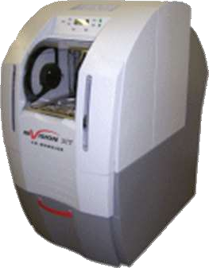
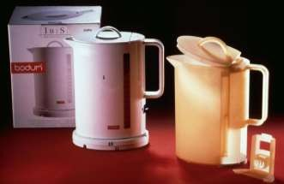
Rapid Prototyping
Rapid prototyping is a broad term technologies used to quickly fabricate computer data.
that comprises many different a physical model directly from
The first rapid prototyping method, called stereo lithography, was developed in the late 1980s, but more sophisticated techniques are available today.

Slide 29
Techniques of Rapid Prototyping
The term “rapid” is relative. Some prototypes may take hours or even days to build. The first rapid prototyping method, called stereo lithography, was developed in the late 1980s, but more sophisticated techniques are available today.
Rapid prototyping systems are additive manufacturing processes that work on the basic principle of producing a 3D part by building and stacking multiple 2D layers together.
Most common types of rapid prototyping techniques (RPT):
SLA (Stereo Lithography)
SLS (Selective Laser Sintering)
LOM (Laminate Object Manufacturing)
FDM (Fused Deposition Modeling).
Different technologies use different materials to produce the parts.

Slide 30



Stereo Lithography (SLA)
It was invented by Chuck Hull in 1986. SLA creates 3D objects layer by layer using a process called photopolymerization.
Works based on the principle of curing liquid photomer into specific shape
Process:
Preparation:
A 3D digital model is sliced into thin layers using computer-aided design (CAD) software.
2.Layering:
The build platform is lowered into the resin tank.
A UV laser selectively traces the cross-section of the model on the liquid resin, solidifying it.
3.Platform Movement:
After a layer is solidified, the platform moves up, and a new layer of liquid resin is spread over the cured layer.
4.Repetition:
Steps 2 and 3 are repeated layer by layer until the entire object is created.
Focusing system _{Rotating mirror}
High-speed stepper motors
He-Cd Laser
UV beam
Sensor system for resin depth
Liquid resin
Part
Support structures
Platform
Elevation control
He-Ne Laser
26

Slide 31
Stereo Lithography (SLA)
Each layer is 0.076 mm to 0.50 mm (0.003 in to 0.020 in.) thick
Thinner layers provide better resolution and more intricate shapes; but
processing time is longer
Starting materials are liquid monomers
Polymerization occurs on exposure to UV light produced by laser scanning
beam
Scanning speeds ~ 500 to 2500 mm/s
Accuracy(mm) - 0.01- 0.2(SLA)
27

Slide 32
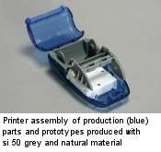
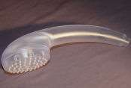
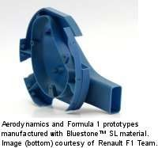
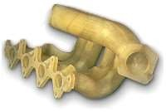
SLA: companies and applications
Companies that develop and sell SLA machines:
3D Systems™ Inc. (www.3Dsystems.com)
Aaroflex Inc (www.aaroflex.com)
Shower head
28
Automobile Manifold
(Rover)

Slide 33
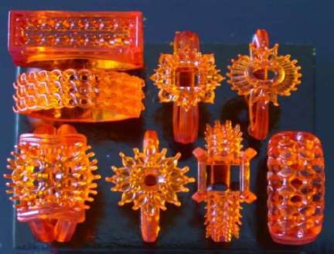
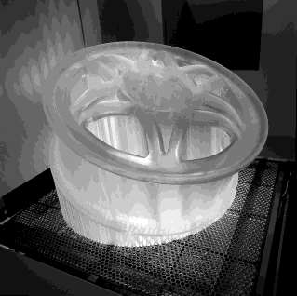
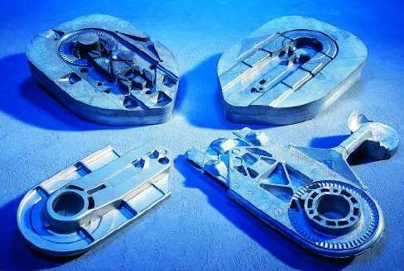
Stereo Lithography (SLA) Parts

Slide 34
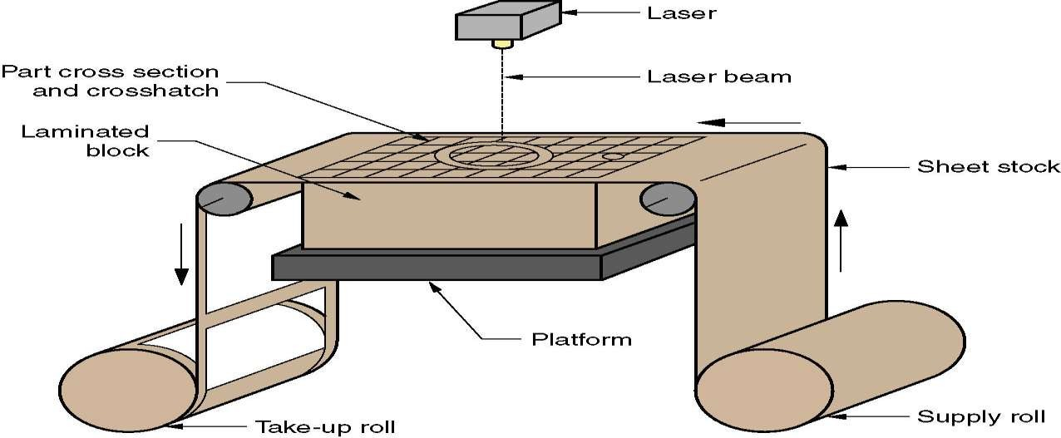
Laminated Object Manufacturing (LOM)

Slide 35
Laminated Object Manufacturing
Laminated Object Manufacturing is a relatively low cost rapid prototyping technology
where thin slices of material (usually paper or wood) are successively glued together
to form a 3D shape.
The process uses two rollers to control the supply of paper with heat-activated glue to a building platform.
When new paper is in position, it is flattened and added to the previously created layers using a heated roller.
The shape of the new layer is traced and cut by a blade or a laser. When the layer
is complete, the building platform descends and new paper is supplied.
When the paper is in position, the platform moves back up so the new layer can be glued to the existing stack, and the process repeats.

Slide 36
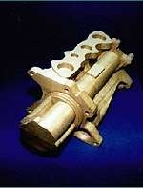
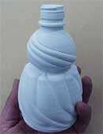
LOM: companies, applications
Original technology developed by Helisys Inc.; Helisys acquired by Corum.
Cubic Technologies Inc [www.cubictechnologies.com]
KIRA Corp, Japan [www.kiracorp.co.jp]
32
[source: Corum Inc]
[source: KIRA corporation]

Slide 37
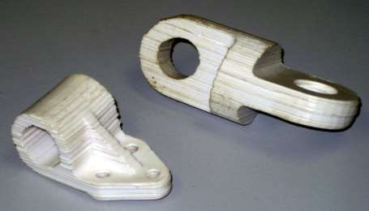
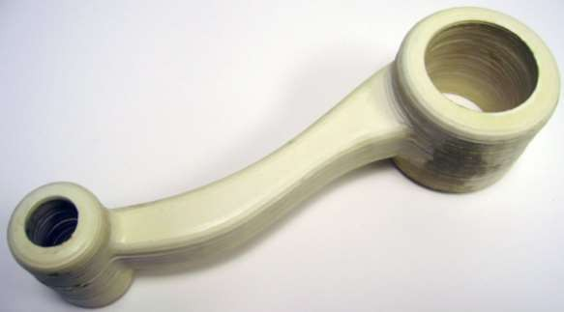
Laminated Object Manufacturing (LOM)

Slide 38
Laminated Object Manufacturing Facts
Layer thickness(mm) - 0.1 - 1(LOM.);
Starting sheet stock includes paper, plastic, cellulose, metals, or fiber-reinforced materials
Accuracy(mm) - 0.1 - 0.2(LOM);

Slide 39
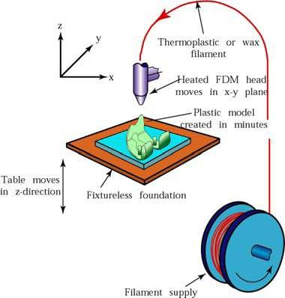
Fused Deposition Modeling
A gantry robot controlled extruder head moves in two principle directions over a table
Table can be raised or lowered as needed
Thermo plastic or wax filament is extruded through the small orifice of heated die
Initial layer placed on a foam foundation with a constant rate
Extruder head follows a
predetermined path from the file
After first layer the table is lowered and subsequent layers are formed
Fig : (a)Fused-deposition-modeling process3.5 (b)The FDM 5000, a fused-decomposition- modeling-machine.

Slide 40
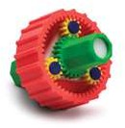
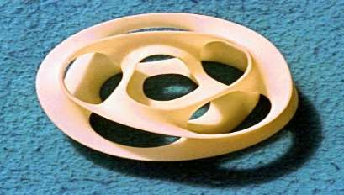
FDM: companies and applications
FDM™ is a patented technology of Stratasys™ Inc.
Gear assembly
Toy design using FDM models of different colors
Monkey Cinquefoil
Designed by Prof Carlo Sequin, UC Berkeley
36
5 monkey-saddles closed into a single edged toroidal ring

Slide 41
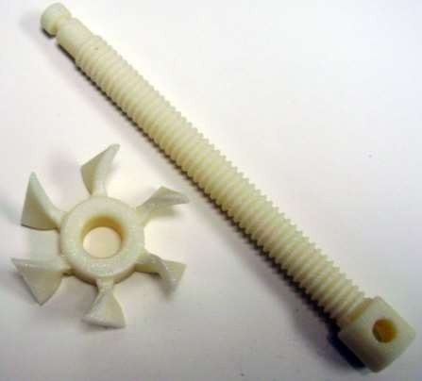
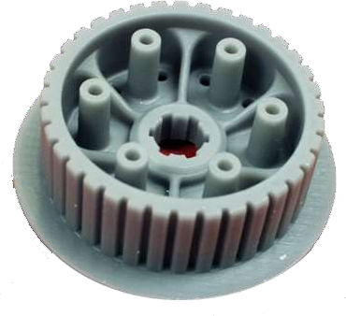
Fused Deposition Modeling (FDM)

Slide 42
Fused Deposition Modeling (FDM)
Materials:
ABS,
Polycarbonate (PC), Polyphenylsulfonen (PPSF) Metals
Layer thickness(mm) - ~0.05(FDM);
Accuracy(mm) - 0.127 - 0.254(FDM);

Slide 43
Selective Laser Sintering (SLS)
Uses a high power laser and powdered materials.
A wide variety of materials can be used, ranging from thermoplastic
polymers, such as nylon and polystyrene, to some metals.
3D parts are produced by fusing a thin slice of the powdered material
onto the layers below it.
The surfaces of SLS prototypes are not as smooth as those produced by SLA processes.
SLS parts are sufficiently strong and resistant for many functional
tests.

Slide 44
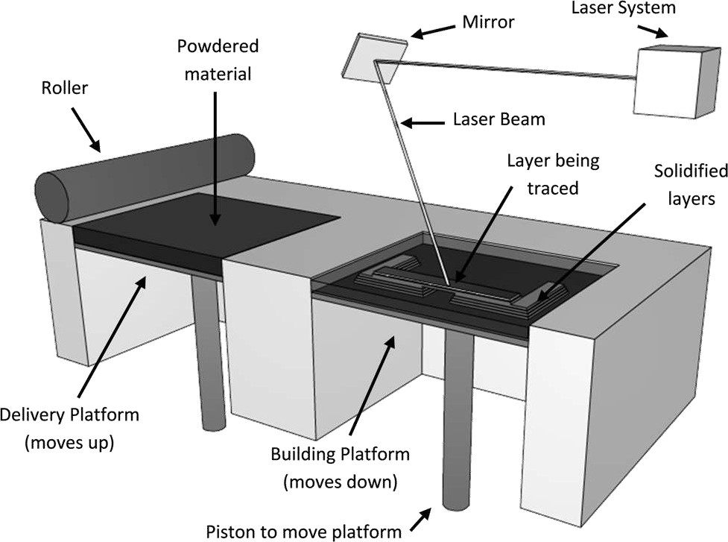
Selective Laser Sintering (SLS)

Slide 45
Selective Laser Sintering (SLS)
The powdered material is kept on a delivery platform and supplied to the building area by a roller.
For each layer, a laser traces the corresponding shape of the part on the surface of the building area, by heating the powder until it melts, fusing it with the layer below it.
The platform containing the part lowers one layer thickness and the platform
supplying the material elevates, providing more material to the system.
The roller moves the new material to the building platform, leveling the surface, and the process repeats.
Some SLS prototype machines use two delivery platforms, one on each side of the building platform, for efficiency, so the roller can supply material to the building platform in both directions.

Slide 46
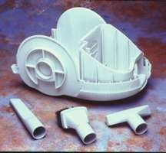
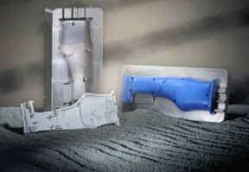
SLS: companies and applications
First commercialized by Prof Carl Deckard (UT Austin) Marketed by DTM Corp.
DTM acquired by 3Dsystems Inc.
3D Systems™ Inc. (www.3Dsystems.com)
EOS GmbH, Munich, Germany.
Plastic parts using SLS
Metal mold using SLS, injection molded parts
42
[both examples, source: DTM inc.]

Slide 47
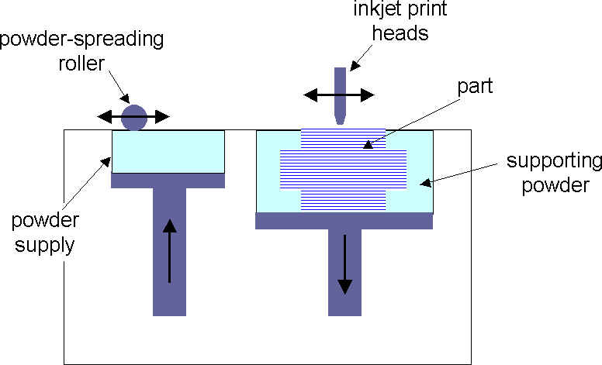
3D printing
Technology invented at MIT in1994, Part constructed with starch powder
Layer of powder spread on platform
Ink-jet printer head deposits drops of water/glue* on part cross- section
Table lowered by layer thickness
New layer of powder deposited above previous layer
Repeat steps 2-4 till part is built
Shake powder to get part

Slide 48
MATERIALS USED:
starch, plaster-ceramic powder, Metal powder
MULTI-COLORED WATER CAN BE USED TO MAKE ARBITRARY COLORED PARTS (SAME AS INK-JET
PRINTING)
Applications of 3DP
CAD-Casting metal parts. A ceramic shell with integral cores can be
fabricated directly from the CAD model
Direct metal parts. It is adaptable to a variety of material systems, allowing the production of metallic/ceramic parts with novel composition
Prototypes with colours and elastic feature

Slide 49
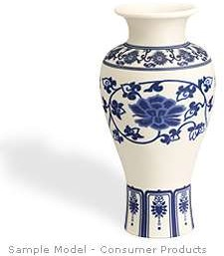
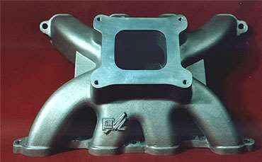
3D Printing: companies, applications
Z-corporation [www.zcorp.com]
Soligen [www.soligen.com]
Engine manifold for GM racing car
Cast after Direct Shell Production Casting
[source: www.soligen.com]
45

Slide 50


46

